Slide 1
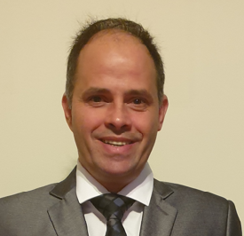

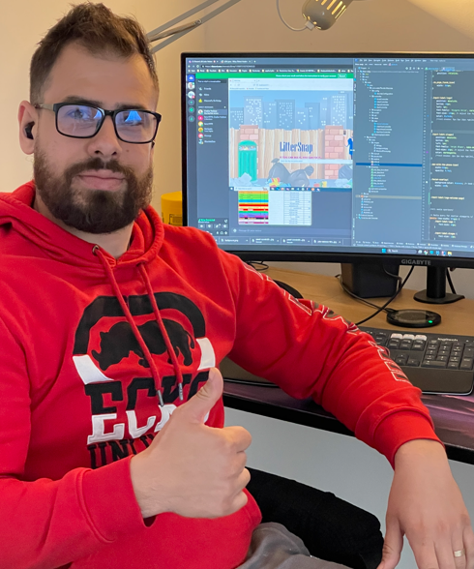



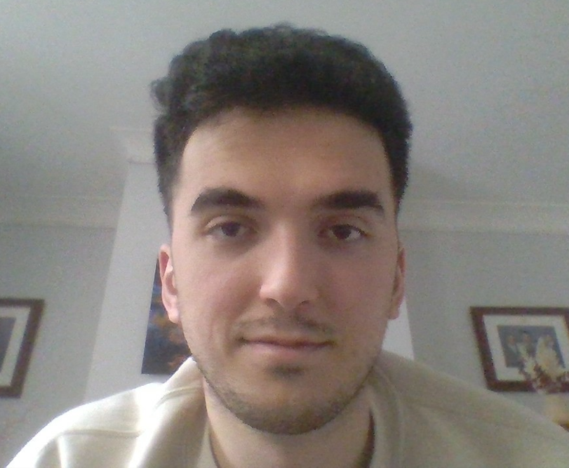

Littersnap
Wiley Edge

Slide 2
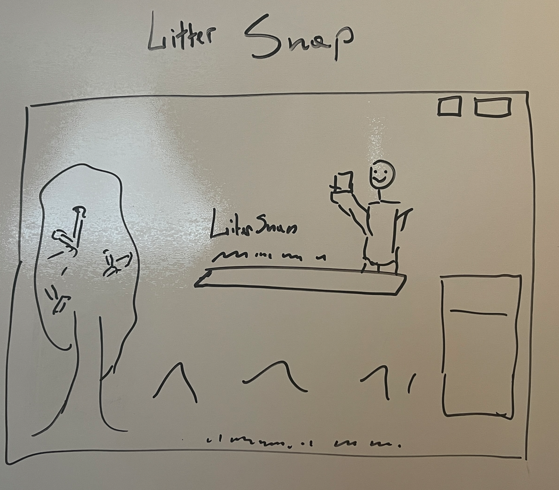

Slide 3
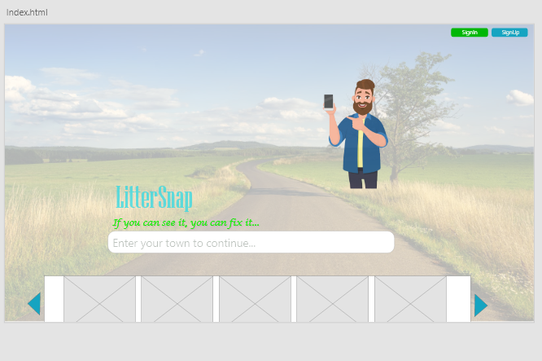

Slide 4
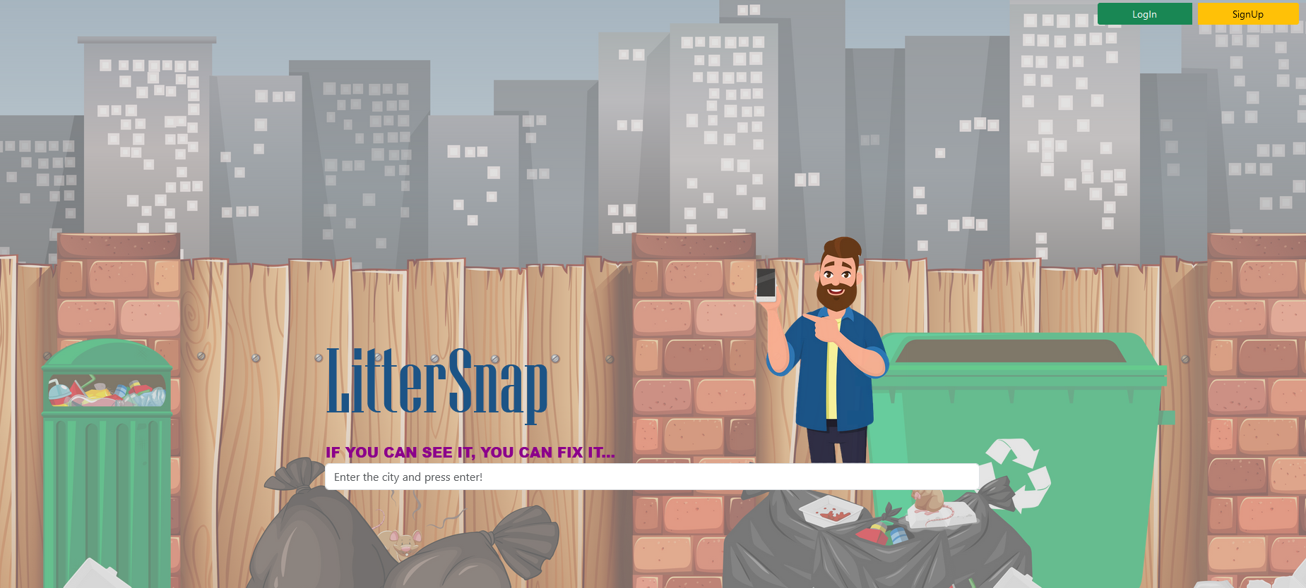

Slide 5

The beginning
It was a very good project idea, but we would also like to implement it as a real project!
Continuous planning (actual and future)
Establishment of basic rules (e.g. Clean code, SOLID principles, MVC pattern, Service repository pattern, OOP principles)
We figured the dependencies out (basic stacks!)
Split the tasks

Slide 6
THE CODING - COLLABORATION
Scrum – Sprint (focusing on the blockers!)
Coding (backend – frontend) – pair programming if needed!
GitHub actions (PR, code review, merge – solve merge conflicts)
Google is our best friend! ☺
Enjoy the teamwork!

Slide 7
Personal Responsibilities
Name | Backend | Frontend
Kevin | user- service (entity, model, repository, service and rest controller), documentation | SignUp & Login pages
Vasile | Address, Litter (entity, model, repository, service and rest controller), documentation | Error, Success & Litter pages
Csaba | GitHub, configuration, basic security (user and admin role), mail service, admin staff, documentation | Index page

Slide 8



Thank you so much for your attention!
The LitterSnap Team:
- Vasile
- Kevin
- Csaba
02 - 06 - 2023

